Slide 1

JCAPS 5.1 Call a JCD within another JCD - POC
Phani Krishna

Slide 2
Scenario
Pre-requisite – will work from 5.1.3 UR2
Components Required
  XSD Files ( For input/output)
  Object Type Definitions
  Connectivity Map
  Java Collaboration
  Deployment Profile
  External Systems ( If any )

Slide 3
Release Notes 5.1.3 UR2
The JCD being called (hereafter termed as “subJCD”) must be implemented as a new web
service operation and cannot be callable as an external SOAP web service.
A subJCD normally contains an input message, an output message and, optionally, some
additional OTDs.
When the top-level JCD is being created, a subJCD can be selected for use in the same way
as a regular OTD at the “Select OTD” step. The top-level JCD can then invoke an operation
defined by the subJCD.
For example, if a subJCD implements a new web service operation named “Callme” with an
input OTD (sub_input_otd) and an output OTD (sub_output_otd), the top-level JCD can
invoke the Callme operation with a method call such as:
sub_output_otd = sub_jcd.getCallme().invoke(sub_input_otd)

Slide 4
Object Type Definitions – Input
Input XSD
  <?xml version="1.0" encoding="UTF-8"?>
  <xsd:schema xmlns:tns="urn:please.define.your.own.target.Add2Input" xmlns:xsd="http://www.w3.org/2001/XMLSchema"
  targetNamespace ="urn:please.define.your.own.target.Add2Input" elementFormDefault="qualified" attributeFormDefault="unqualified">
  <xsd:complexType name="Add2Input">
  <xsd:sequence maxOccurs="unbounded">
  <xsd:element name="num1" type="xsd:integer"/>
  <xsd:element name="num2" type="xsd:integer"/>
  </xsd:sequence>
  </xsd:complexType>
  <xsd:annotation>
  <xsd:documentation>Comment describing your root element</xsd:documentation>
  </xsd:annotation>
  <xsd:element name="Add2Input" type="tns:Add2Input"/>
  </xsd:schema>

Slide 5
Object Type Definitions – Output
Output XSD
  <?xml version="1.0" encoding="UTF-8"?>
  <xsd:schema xmlns:tns="urn:please.define.your.own.target.Add2Output" xmlns:xsd="http://www.w3.org/2001/XMLSchema"
  targetNamespace ="urn:please.define.your.own.target.Add2Output" elementFormDefault="qualified" attributeFormDefault="unqualified">
  <xsd:complexType name="Add2Output">
  <xsd:sequence maxOccurs="unbounded">
  <xsd:element name="Result" type="xsd:integer"></xsd:element>
  </xsd:sequence>
  </xsd:complexType>
  <xsd:annotation>
  <xsd:documentation>Comment describing your root element</xsd:documentation>
  </xsd:annotation>
  <xsd:element name="Add2Output" type="tns:Add2Output"/>
  </xsd:schema>

Slide 6
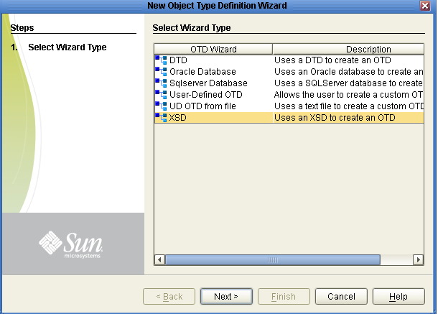
Building OTDs using OTD wizard

Slide 7
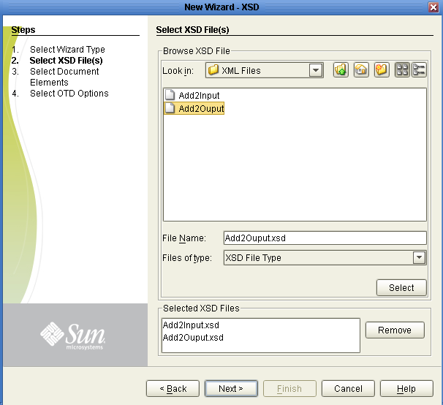
Building OTDs using OTD wizard (cont)

Slide 8
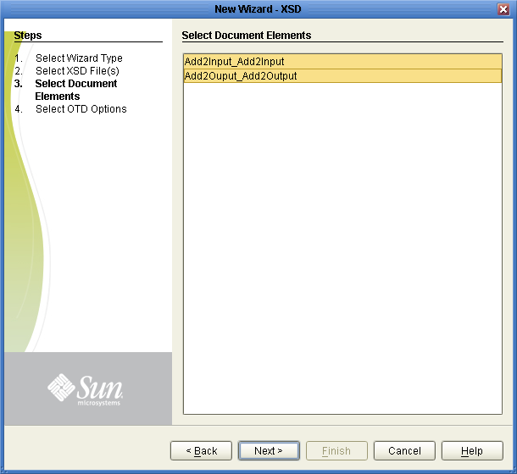
Building OTDs using OTD wizard(cont)

Slide 9
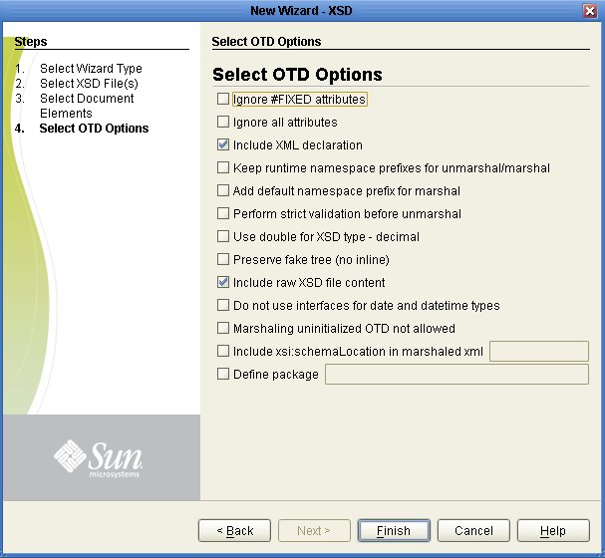
Building OTDs using OTD wizard(cont)

Slide 10
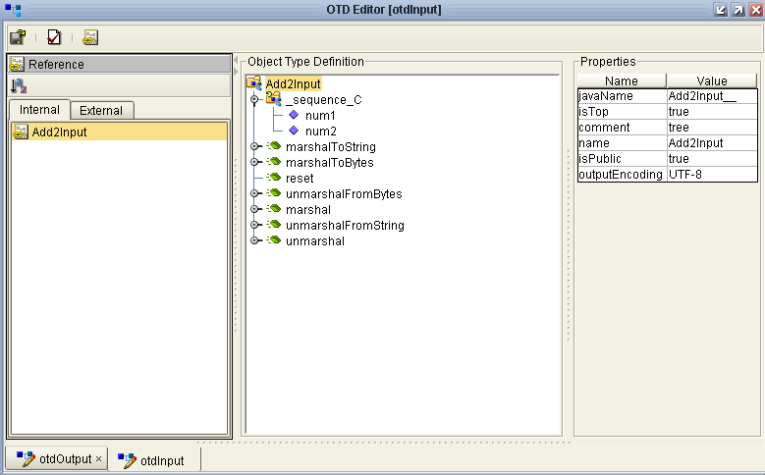
Request OTD

Slide 11
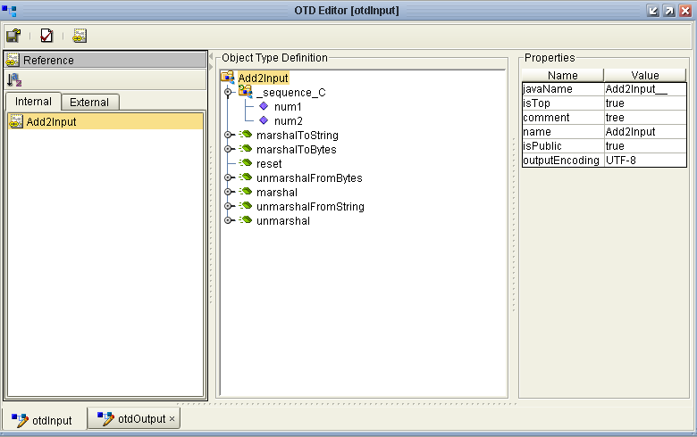
Response OTD

Slide 12
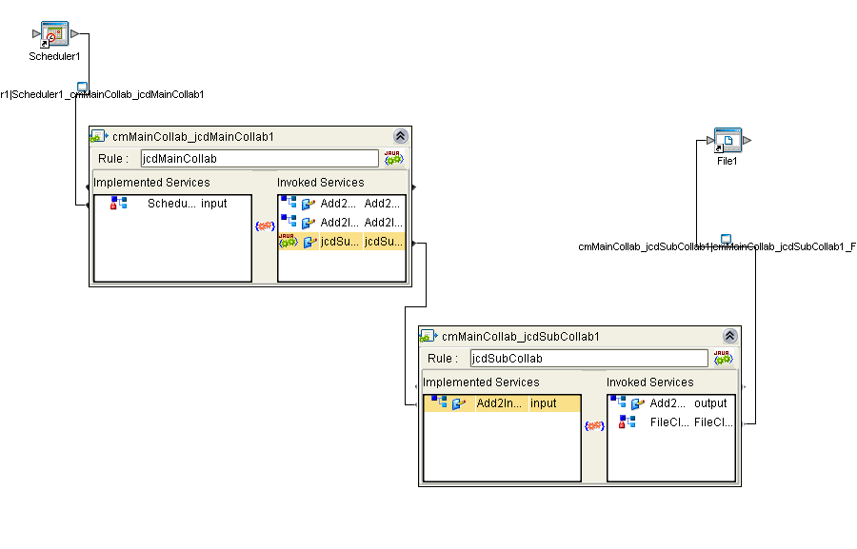
Connectivity Map

Slide 13
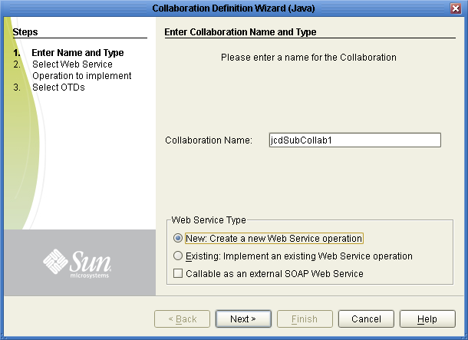
Sub JCD Creation

Slide 14
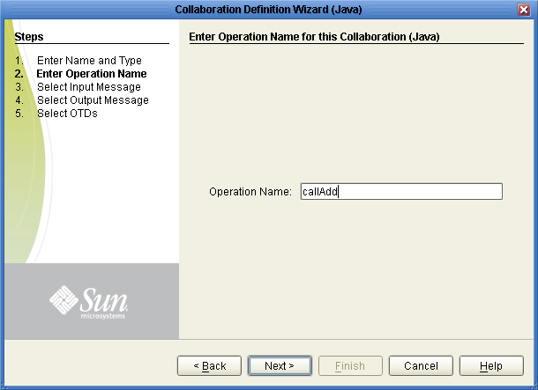
Sub JCD Creation (cont)

Slide 15
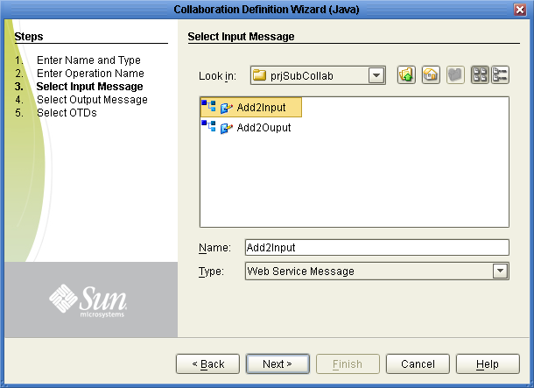
Sub JCD Creation (cont)

Slide 16

Sub JCD Creation (cont)

Slide 17
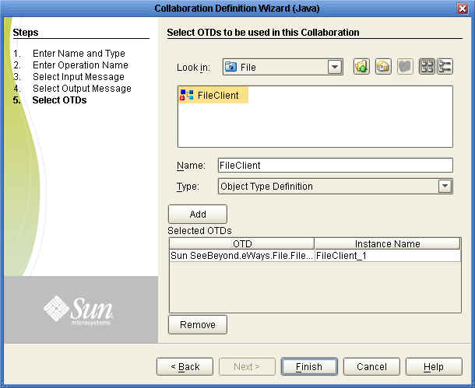
Sub JCD Creation (cont)

Slide 18
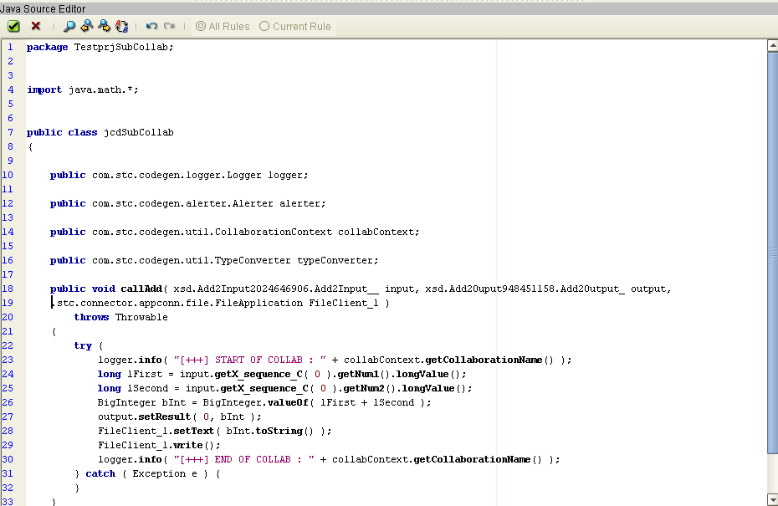
Sub Jcd Code
(svcSubCollab)

Slide 19
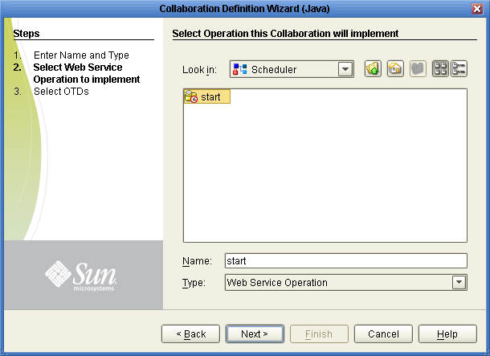
Main JCD Creation

Slide 20
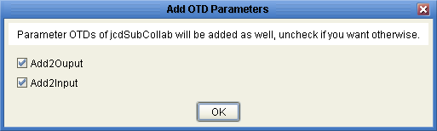
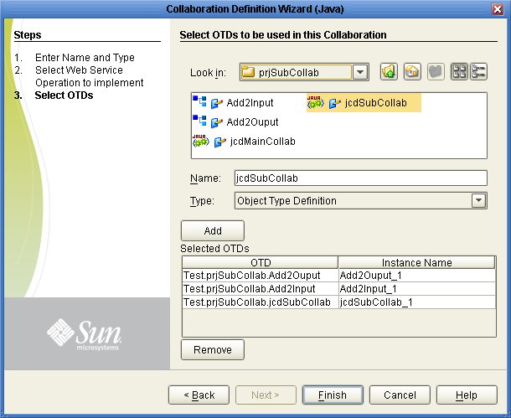
Main JCD Creation(cont)

Slide 21
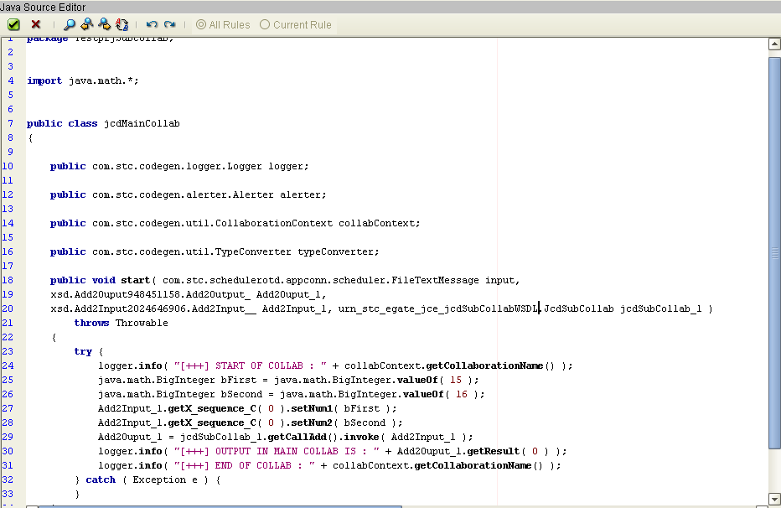
Main Jcd Code
(svcMainCollab)

Slide 22
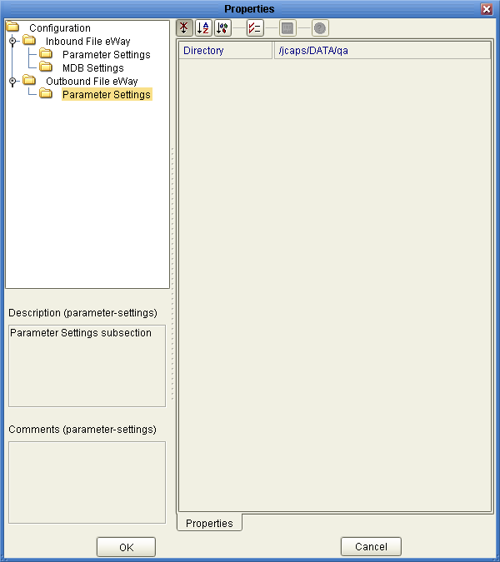
External System
( if any - esFile)

Slide 23
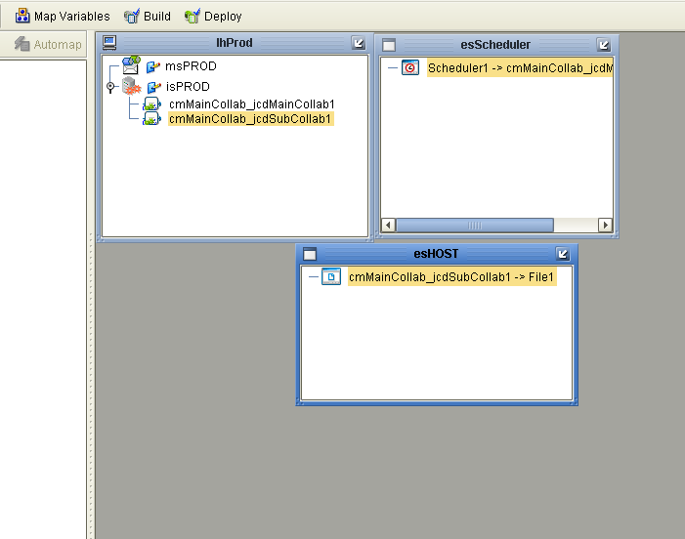
Deployment Profile
(dpMainCollab)

Slide 24
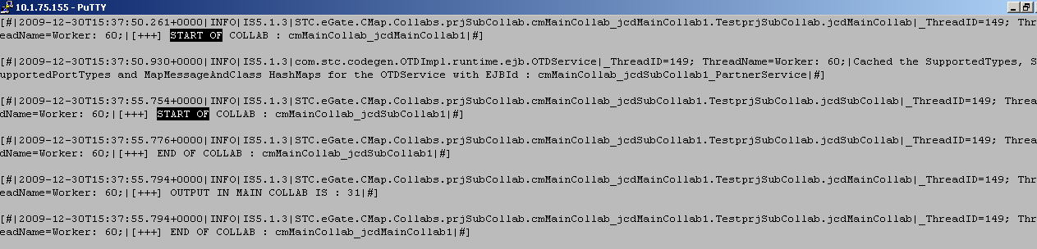
Output in Server.log file

Slide 25
Thank You
Phani Krishna

